Slide 1
PHY 203 LECTURE NOTE II COURSE TITLE: ELEMENTARY MODERN PHYSICS II
BY
LECTURER:DR ALAUSA S. K
&
CO-LECTURER:DR AJETUNMOBI A.E
PHYSICS DEPARTMENT,
OLABISI ONABANJO UNIVERSITY,
AGO-IWOYE,
OGUN STATE.

Slide 2
BLACK BODY RADIATION
A blackbody is an theoretical body that absorbs all electromagnetic radiation falling on it.
It is a hypothetical object which is a perfect absorber and a perfect emitter of wavelengths radiation.
The term originates because for a blackbody all visible light will be absorbed rather than reflected, and therefore the surface will appear black
A star, like the Sun is a near perfect blackbody. A blackbody does not reflect any light, nor does it allow any light to pass through (transmit).

Slide 3
Stefan–Boltzmann Law
How much energy an object radiates (per a given surface area) is a function of the surface temperature of the object. This property is expressed by the Stefan–Boltzmann law:
M= σ T ⁴ M = Total energy emitted from the surface of a material (Watts/m²) σ = Stefan-Boltzmann constant, 5.6697 x 10⁻⁸ W/m² K ⁴ T = Temperature of the emitting material in Kelvin

Slide 4
Stefan–Boltzmann Law……..
The Stefan-Boltzmann Law gives the total energy being emitted at all wavelengths by the blackbody
It is important to note is that the total energy increases rapidly with temperature, since it varies to the fourth power of the temperature.
There is no object that is an ideal blackbody, but many objects (stars included) behave approximately like blackbodies.

Slide 5
WIEN’S DISPLACEMENT LAW
Blackbodies emit radiation across multiple wavelengths.
The cooler the object, the longer the wavelength at which most of the radiation will be emitted.
Conversely, the hotter the object, the shorter the wavelength at which the peak radiation is emitted.
This relationship is represented by Wien’s Displacement Law:
λ_{m} = A/T λ_{m} = Wavelength of maximum radiation A = 2898 μm K or ~2.9 x 10⁻³m K T = Temperature in Kelvin

Slide 6
WIEN’S DISPLACEMENT LAW….
The wavelength at which maximum energy is emitted in inversely related to the blackbody’s temperature.
The spectrum of a blackbody is continuous, meaning it gives off some energy across all wavelengths, but it has a peak at a specific wavelength.
The peak of the blackbody curve in a spectrum moves to shorter wavelengths for hotter objects, for example the Sun emits peak energy at shorter wavelengths compared to a much cooler planet like the Earth.

Slide 7
Blackbody Radiation Curves
The intensity and distribution (and peak) of the radiation depends only on its temperature.
The graphical representation of this is commonly known as a Blackbody Radiation Curve.
For example our Sun has an approximate temperature of 5800K, and emits peak radiation in the visible portion of the spectrum.
The Earth on the other hand is significantly cooler and emits a fraction of the energy and peaks in in much longer wavelengths in what's known as the thermal infrared portion of the spectrum.

Slide 8
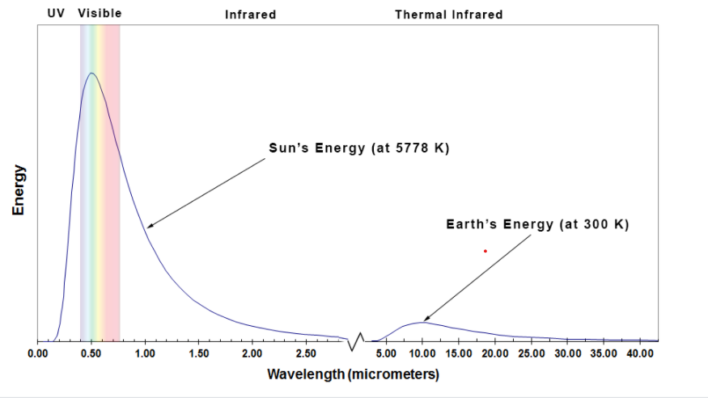
Blackbody Radiation Curves……

Slide 9
Blackbody Radiation Curves……
The y-axis of a blackbody chart represents the amount of energy radiated by a blackbody while the x-axis represent the wavelength.
By looking at the magnitude of the curve (height), we can determine the energy radiated by a body at a specific wavelength.
The area under the curve represents the total energy radiated across all wavelengths.
By locating the peak (highest point) of the curve, we can determine at what wavelength the greatest amount of energy is emitted at.

Slide 10
Blackbody Radiation Curves……
In the above graph, we can see that the Sun, with a temperature of approximately 5800 Kelvin, emits a significant of energy and that most of this energy is emitted between 0.4-0.7 micrometers in the visible wavelengths.
The Stefan-Boltzmann Law and Wien’s Displacement Law are important to remote sensing because they tell us how much energy a body will produce based on its temperature and where in the electromagnetic spectrum this energy will peak.
This is important when designing and selecting sensors

Slide 11
Blackbody Radiation Curves……
Remote sensing is the process of detecting and monitoring the physical characteristics of an area by measuring its reflected and emitted radiation at a distance (typically from satellite or aircraft).
Special cameras collect remotely sensed images, which help researchers "sense" things about the Earth.

Slide 12
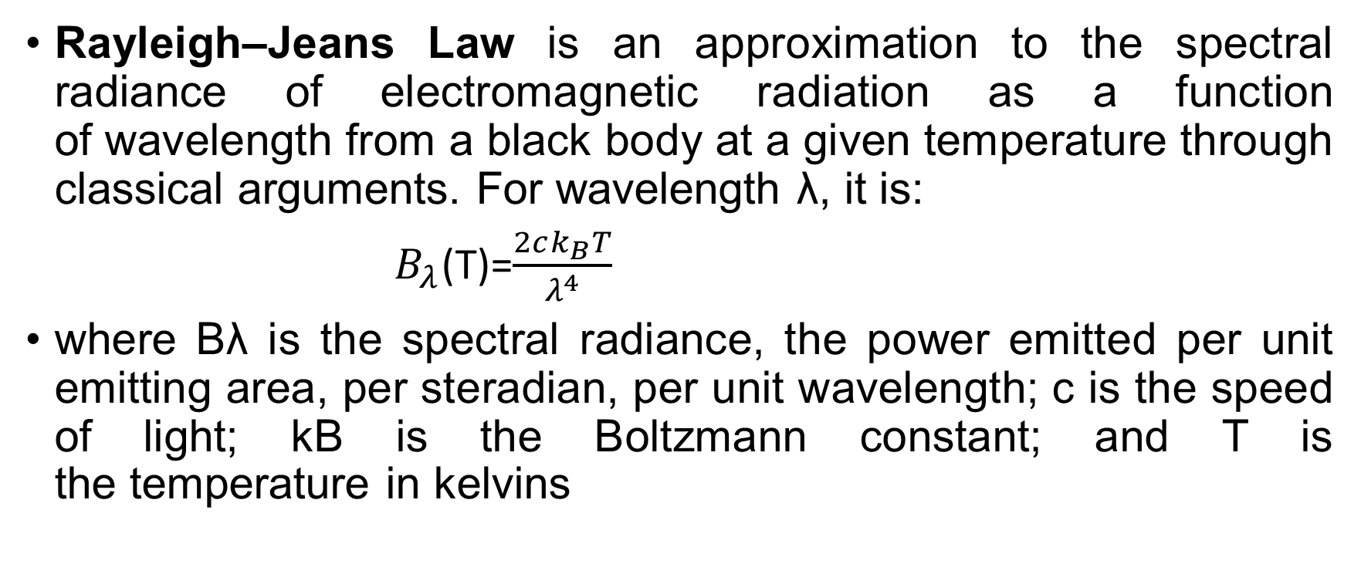
RAYLEIGH–JEANS LAW
Rayleigh–Jeans Law is an approximation to the spectral radiance of electromagnetic radiation as a function of wavelength from a black body at a given temperature through classical arguments. For wavelength λ, it is:
$B_{λ}$(T)=$\frac{2ck_{B}T}{λ^{4}}$
where Bλ is the spectral radiance, the power emitted per unit emitting area, per steradian, per unit wavelength; c is the speed of light; kB is the Boltzmann constant; and T is the temperature in kelvins

Slide 13
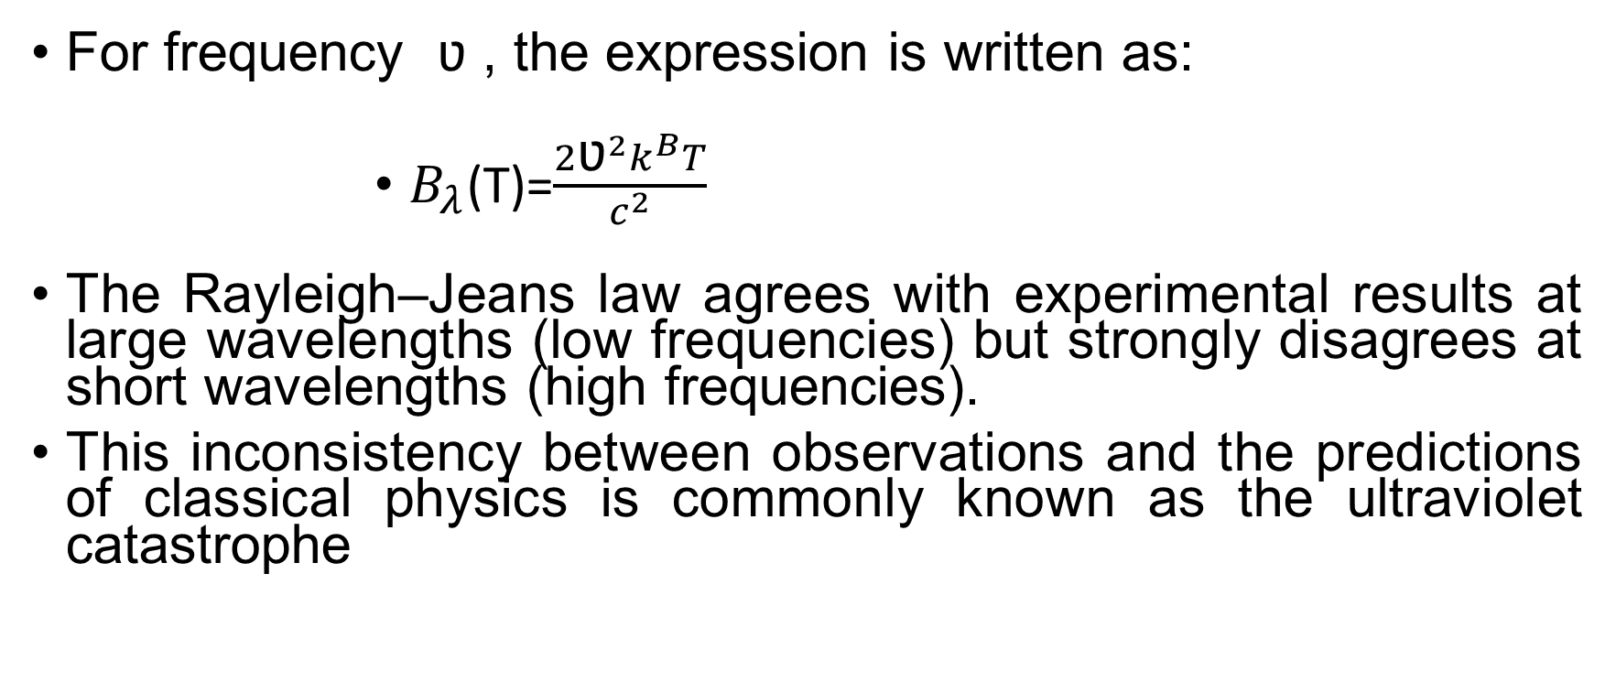
RAYLEIGH–JEANS LAW…
For frequency ʋ , the expression is written as:
$B_{λ}$(T)=$\frac{2{\text{ʋ}}^{2}k^{B}T}{\begin{aligned}c^{2} \\ \end{aligned}}$
The Rayleigh–Jeans law agrees with experimental results at large wavelengths (low frequencies) but strongly disagrees at short wavelengths (high frequencies).
This inconsistency between observations and the predictions of classical physics is commonly known as the ultraviolet catastrophe

Slide 14
RAYLEIGH–JEANS LAW….
The significance of this inadequate so-called law is that it provides an asymptotic condition which other proposed formulas, such as Planck's, need to satisfy.
It gives a value to an otherwise arbitrary constant in Planck's thermal radiation formula.

Slide 15
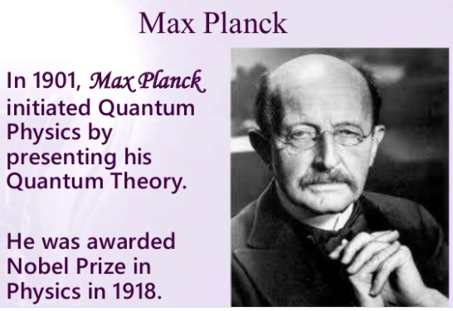
PLANCK’S THEORY

Slide 16
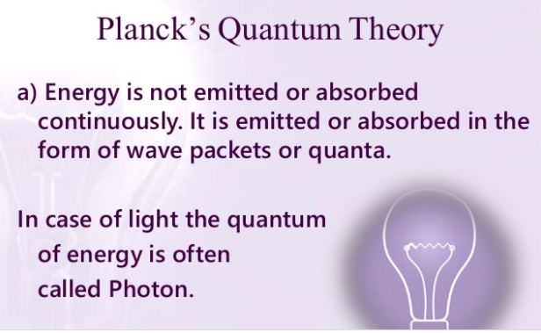
PLANCK’S THEORY…..

Slide 17
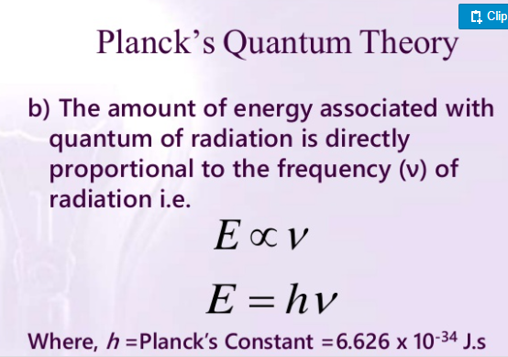

Slide 18
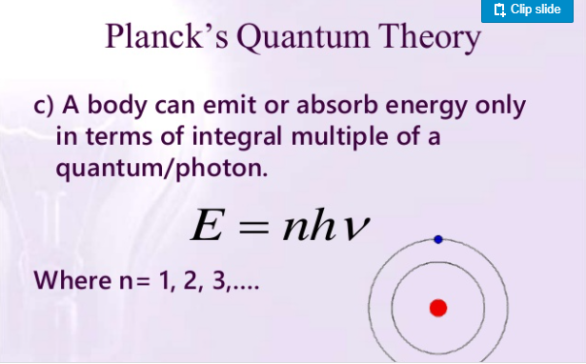
PLANCK’S THEORY…..

Slide 19
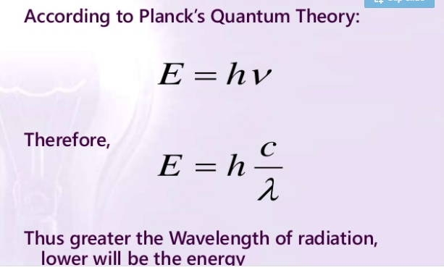
PLANCK’S THEORY…..

Slide 20
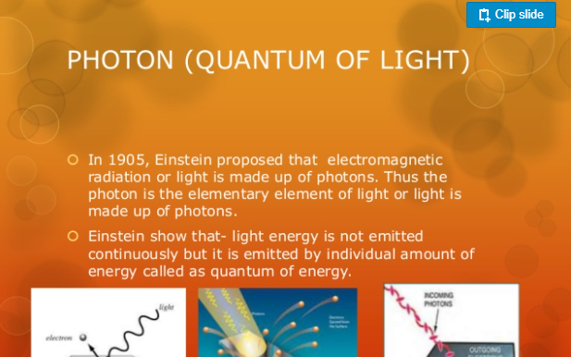
PHOTOELECTRIC EFFECT

Slide 21
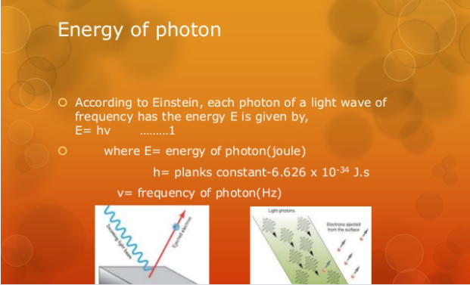
PHOTOELECTRIC EFFECT…..

Slide 22
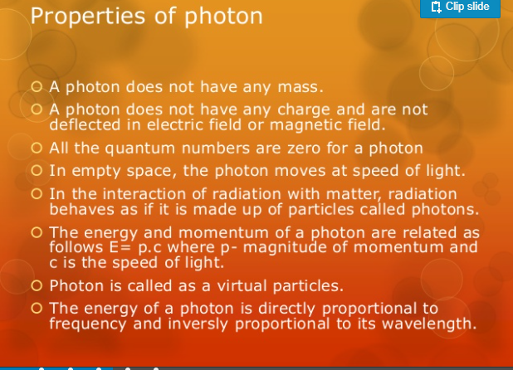
PHOTOELECTRIC EFFECT

Slide 23
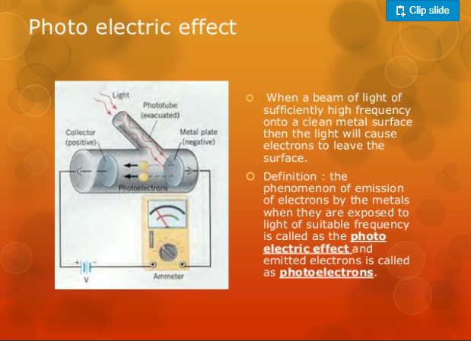
PHOTOELECTRIC EFFECT……

Slide 24
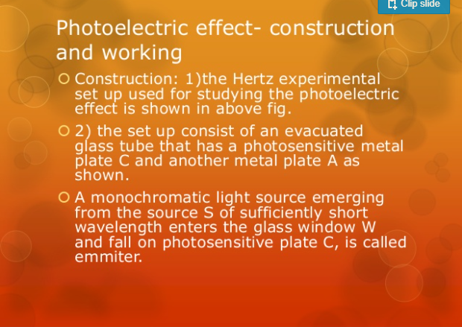
PHOTOELECTRIC EFFECT…..

Slide 25
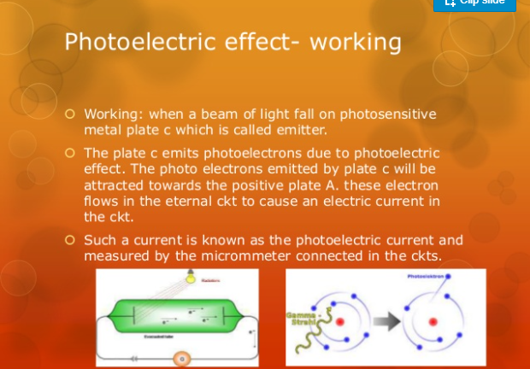
PHOTOELECTRIC EFFECT……

Slide 26
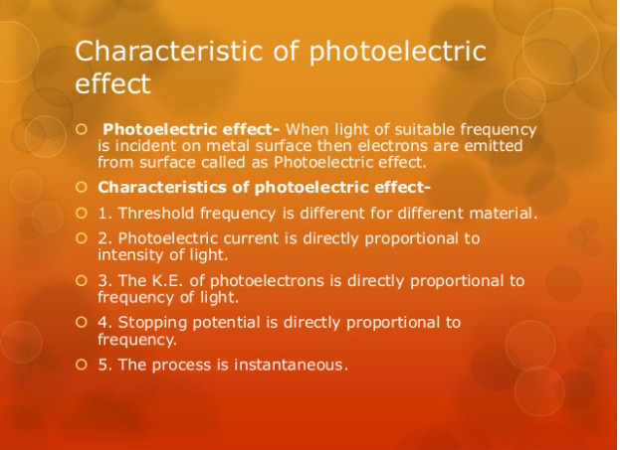
PHOTOELECTRIC EFFECT….

Slide 27
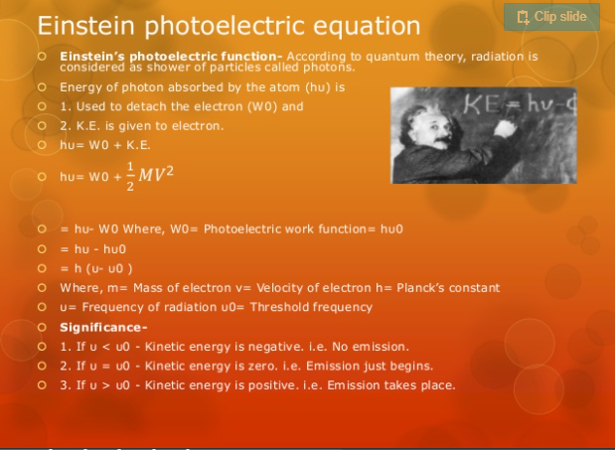
PHOTOELECTRIC EFFECT…….

Slide 28
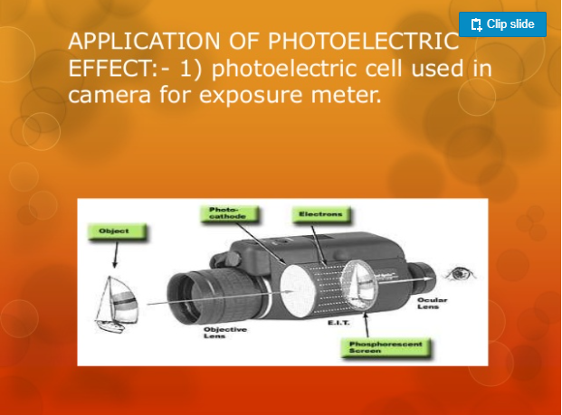
PHOTOELECTRIC EFFECT……..

Slide 29
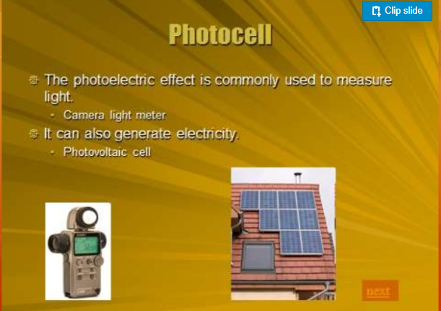
PHOTOELECTRIC EFFECT…….

Slide 30
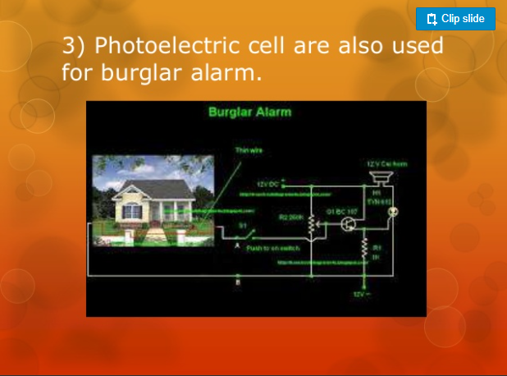
PHOTOELECTRIC EFFECT…….

Slide 31
COMPTON EFFECT
The Compton effect (also called Compton scattering) is the result of a high-energy photon colliding with a target, which releases loosely bound electrons from the outer shell of the atom or molecule.
The scattered radiation experiences a wavelength shift that cannot be explained in terms of classical wave theory, thus lending support to Einstein's photon theory.

Slide 32
COMPTON EFFECT…..
A schematic diagram of the apparatus used by Compton is shown in the Figure below.
A graphite target was bombarded with monochromatic x-rays and the wavelength of the scattered radiation was measured with a rotating crystal spectrometer.
The intensity was determined by a movable ionization chamber that generated a current proportional to the x-ray intensity. Compton measured the dependence of scattered x-ray intensity on wavelength at three different scattering angles of 45º 90º ,and 135º

Slide 33
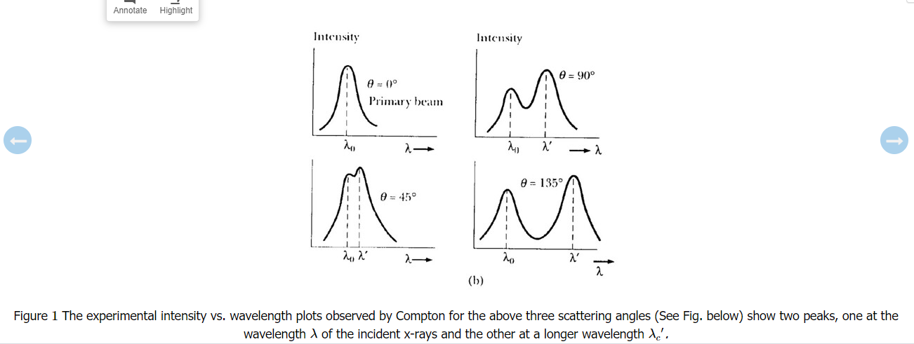
COMPTON EFFECT…..

Slide 34
COMPTON EFFECT…..
Compton effect is the decrease in energy (increase in wavelength) of an X-ray or gamma ray photon, when it interacts with matter.
Because of the change in photon energy, it is an inelastic scattering process.
Inverse Compton scattering also exists, where the photon gains energy (decreasing in wavelength) upon interaction with matter.
Compton used a combination of three fundamental formulas representing the various aspects of classical and modern physics, combining them to describe the quantum behavior of light:
Light as a particle, as noted in the photoelectric effect
Relativistic dynamics: special theory of relativity
Trigonometry: law of cosines

Slide 35
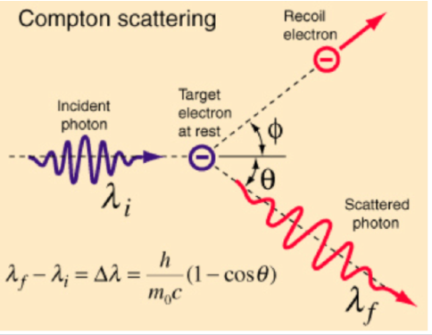
COMPTON EFFECT

Slide 36
APPLICATIONS OF COMPTON EFFECT
Compton scattering is of prime importance to radiobiology, as it happens to be the most probable interaction of high energy X rays with atomic nuclei in living beings and is applied in radiation therapy.
In material physics, Compton scattering can be used to probe the wave function of the electrons in matter in the momentum representation.
Compton scattering is an important effect in gamma spectroscopy which gives rise to the Compton edge, as it is possible for the gamma rays to scatter out of the detectors used.
Compton suppression is used to detect stray scatter gamma rays to counteract this effect.

Slide 37
PAIR PRODUCTION
Pair production is the formation or materialization of two electrons, one negative and the other positive (positron), from a pulse of electromagnetic energy traveling through matter, usually in the vicinity of an atomic nucleus.
Pair production is a direct conversion of radiant energy to matter. It is one of the principal ways in which high-energy gamma rays are absorbed in matter.
For pair production to occur, the electromagnetic energy, in a discrete quantity called a photon, must be at least equivalent to the mass of two electrons.
The mass m of a single electron is equivalent to 0.51 million electron volts (MeV) of energy E as calculated from the equation formulated by Albert Einstein, E = mc², in which c is a constant equal to the velocity of light.

Slide 38
PAIR PRODUCTION
To produce two electrons, therefore, the photon energy must be at least 1.02 MeV. Photon energy in excess of this amount, when pair production occurs, is converted into motion of the electron-positron pair.
If pair production occurs in a track detector, such as a cloud chamber, to which a magnetic field is properly applied, the electron and the positron curve away from the point of formation in opposite directions in arcs of equal curvature.
In this way pair production was first detected (1933). The positron that is formed quickly disappears by reconversion into photons in the process of annihilation with another electron in matter.

Slide 39
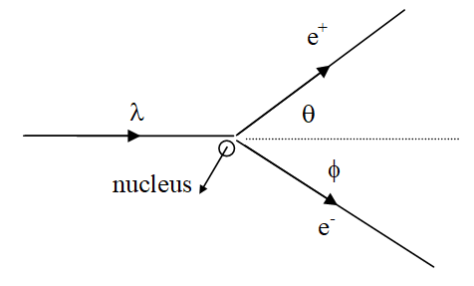
SCEMATIC DIAGRAM FOR FORMATION OF PAIR PRODUCTION

Slide 40
REDSHIFT PHENOMENON
Red shift' is a key concept for astronomers.
The term can be understood literally - the wavelength of the light is stretched, so the light is seen as 'shifted' towards the red part of the spectrum.
Something similar happens to sound waves when a source of sound moves relative to an observer.
Amazon Redshift is a fully-managed petabyte-scale cloud based data warehouse product designed for large scale data set storage and analysis.
It is also used to perform large scale database migrations.

Slide 41
REDSHIFT PHENOMENON..
In the widely accepted cosmological model based on general relativity.
Redshift is mainly a result of the expansion of space.
This means that the farther away a galaxy is from us, the more the space has expanded in the time since the light left that galaxy, so the more the light has been stretched, the more redshifted

Slide 42
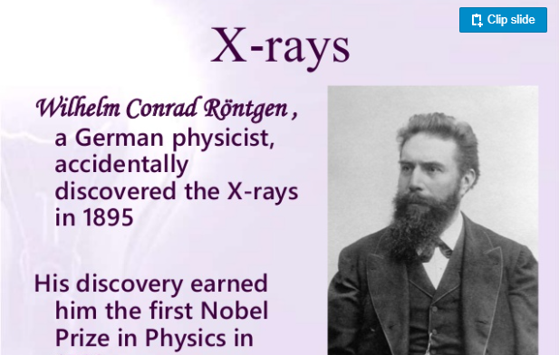
PRODUCTION OF X-RAY

Slide 43
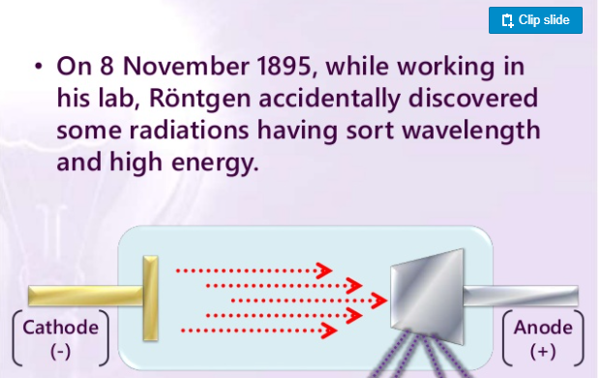
PRODUCTION OF X-RAY….

Slide 44
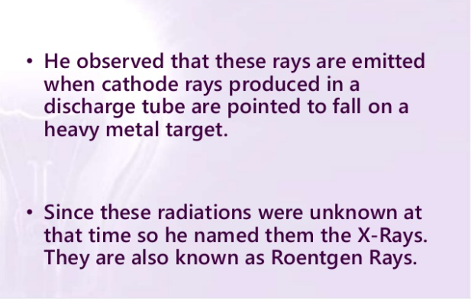
PRODUCTION OF X-RAY……

Slide 45
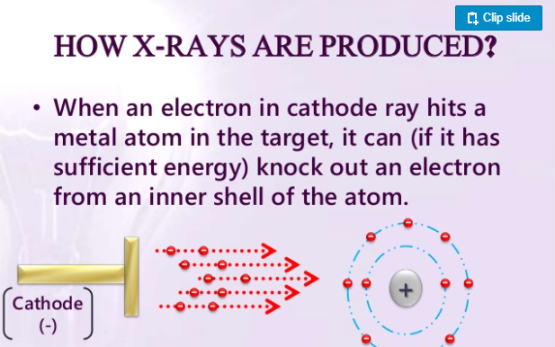
PRODUCTION OF X-RAY………

Slide 46
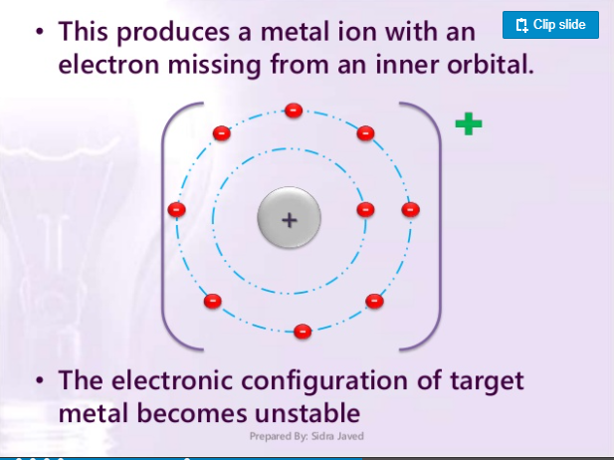
PRODUCTION OF X-RAY…..

Slide 47
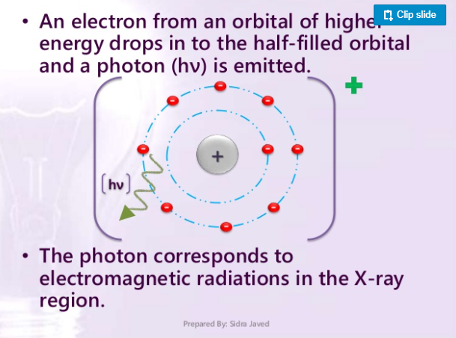
PRODUCTION OF X-RAY…………

Slide 48
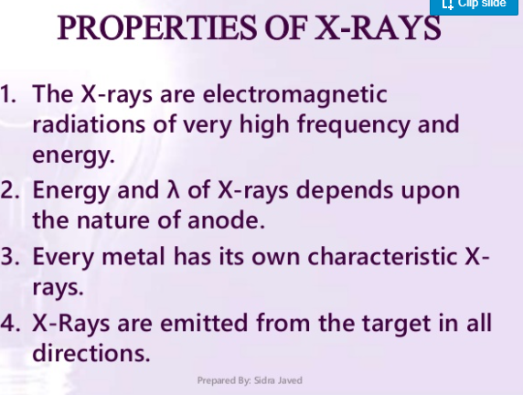
PRODUCTION OF X-RAY……….

Slide 49
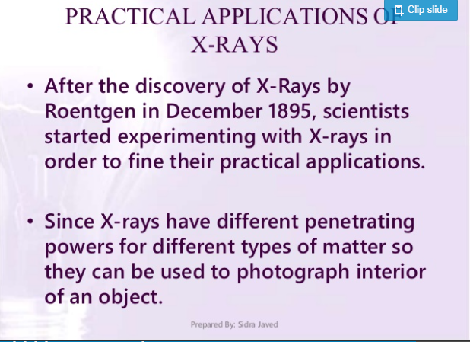
PRODUCTION OF X-RAY……………….

Slide 50

PRODUCTION OF X-RAY……………….

Slide 51
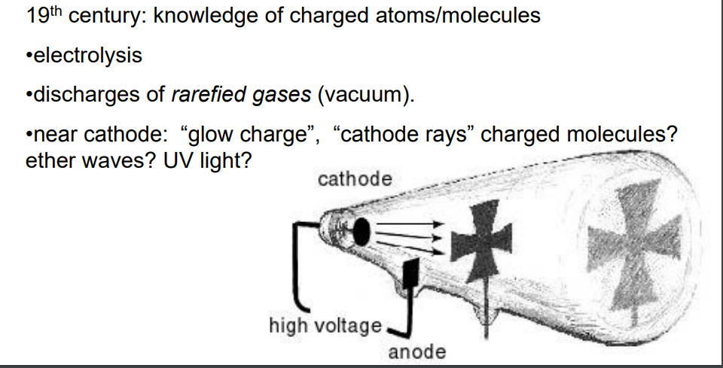
THE DISCOVERY OF X-RAY AND ELECTRONS: GAS DISCHARGE

Slide 52
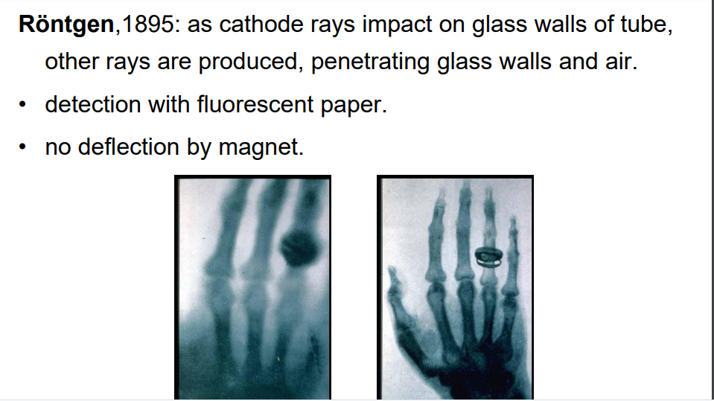

Slide 53
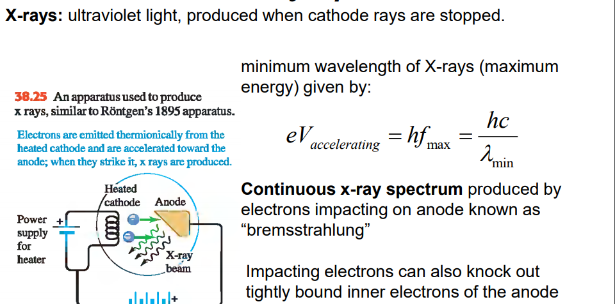
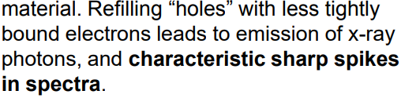
X-RAY SPECTRA

Slide 54
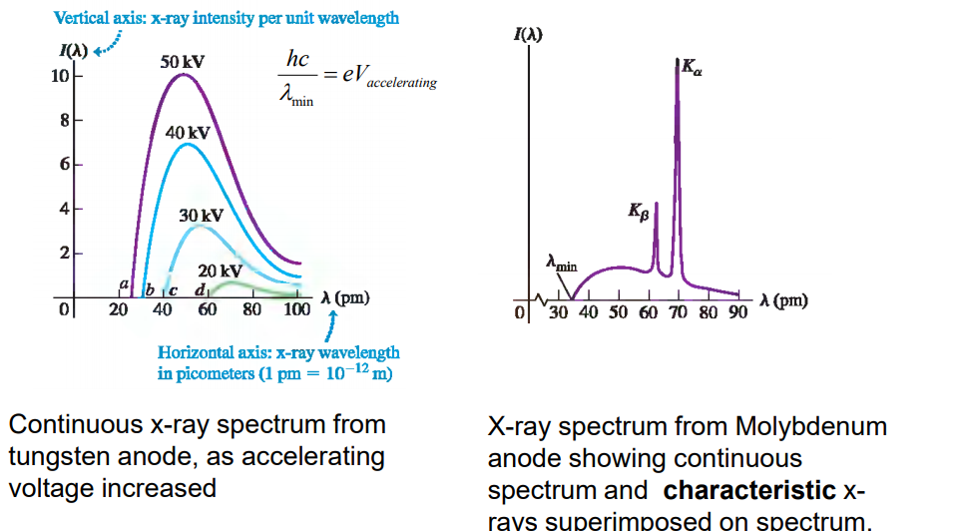
X-RAY SPECTRA…..

Slide 55
DISCHARGE TUBE: DEFINITION
A closed vessel having electrodes at either end and containing a gas at low pressure.
When a sufficient voltage is applied to the electrodes, an electric current flows through the gas.
Any device in which a flow of electrons (ions) through a gas acts as a source of light.
A closed insulating vessel containing a gas at low pressure through which an electric current flows when sufficient voltage is applied to its electrodes.
Any of various devices in which a gas or metal vapor inside sealed glass is used to conduct current when voltage is applied.

Slide 56
PRINCIPLE OF OPERATION OF DISCHARGE TUBE
The discharge lamps work on the fundamental principle that, light is emitted when the electrons have collided with each other.
To obtain this, the first gas an ionized at very high voltage. At low pressure, gas maintained in a glass tube.

Slide 57
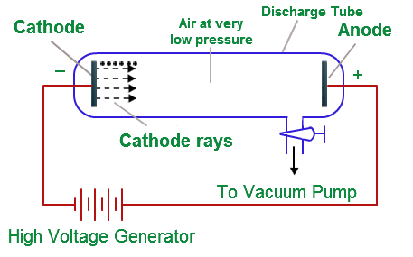
SCHEMATIC DIAGRAM FOR DISCHARGE TUBE

Slide 58
USES OF DISCHARGE TUBE
Discharge tubes can be used to prevent current flow below a certain voltage.
They can also function as lamps by the use of ionizing gas, which glows when current flows through the tube.

Slide 59
CHARGE OF ELECTRON: MILLIKAN’S OIL DROP EXPERIMENT
Millikan oil-drop experiment, first direct and compelling measurement of the electric charge of a single electron.
It was performed originally in 1909 by the American physicist Robert A.
Millikan, who devised a straightforward method of measuring the minute electric charge that is present on many of the droplets in an oil mist.
The force on any electric charge in an electric field is equal to the product of the charge and the electric field.

Slide 60
Millikan was able to measure both the amount of electric force and magnitude of electric field on the tiny charge of an isolated oil droplet.
The data determine the magnitude of the charge itself.

Slide 61
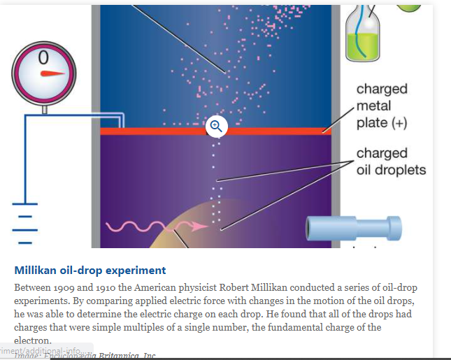
SCEMATIC DIAGRAM FOR MILLIKAN OIL DROP EXPERIMENT

Slide 62
MILLIKAN’S OIL DROP EXPERIMENT
A closed chamber with transparent sides is fitted with two parallel metal plates, which acquire a positive or negative charge when an electric current is applied.
At the start of the experiment, an atomizer sprays a fine mist of oil droplets into the upper portion of the chamber. Under the influence of gravity and air resistance, some of the oil droplets fall through a small hole cut in the top metal plate.
When the space between the metal plates is ionized by radiation (e.g., X-rays), electrons from the air attach themselves to the falling oil droplets, causing them to acquire a negative charge.
A light source, set at right angles to a viewing microscope, illuminates the oil droplets and makes them appear as bright stars while they fall.

Slide 63
MILLIKAN’S OIL DROP EXPERIMENT
The mass of a single charged droplet can be calculated by observing how fast it falls.
By adjusting the potential difference, or voltage, between the metal plates, the speed of the droplet’s motion can be increased or decreased; when the amount of upward electric force equals the known downward gravitational force, the charged droplet remains stationary.
The amount of voltage needed to suspend a droplet is used along with its mass to determine the overall electric charge on the droplet.
Through repeated application of this method, the values of the electric charge on individual oil drops are always whole-number multiples of a lowest value—that value being the elementary electric charge itself (about 1.602 × 10⁻¹⁹ coulomb).

Slide 64
MILLIKAN’S OIL DROP EXPERIMENT
From the time of Millikan’s original experiment, this method offered convincing proof that electric charge exists in basic natural units.
All subsequent distinct methods of measuring the basic unit of electric charge point to its having the same fundamental value.

Slide 65
MASS OF AN ELECTRON
The invariant mass of an electron is approximately 9.109×10⁻³¹ kilograms, or 5.489×10⁻⁴ atomic mass units.
On the basis of Einstein's principle of mass–energy equivalence, this mass corresponds to a rest energy of 0.511 MeV.
The ratio between the mass of a proton and that of an electron is about 1836.

Slide 66
MASS OF AN ELECTRON
Electric charge: −1 e; −1.602176634×10−19 C.
Mass: 9.1093837015(28)×10−31 kg; 5.485799
Magnetic moment: −1.00115965218091(26) μ_{B}

